Slide 1

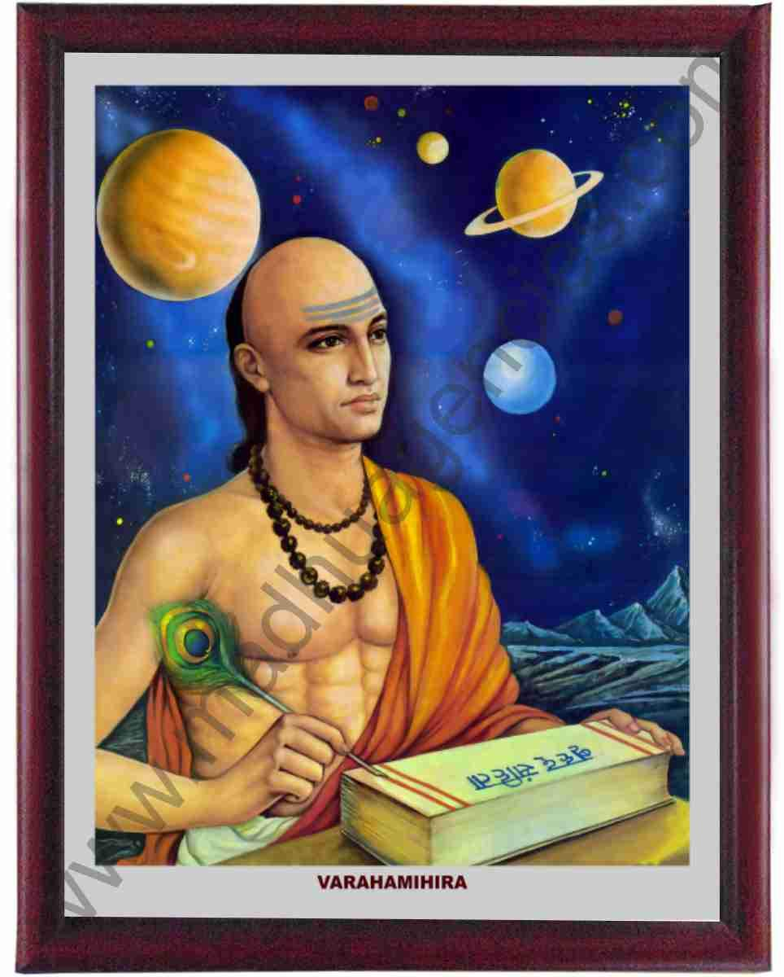
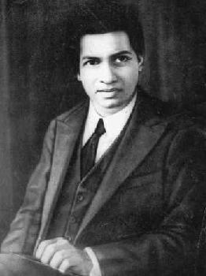
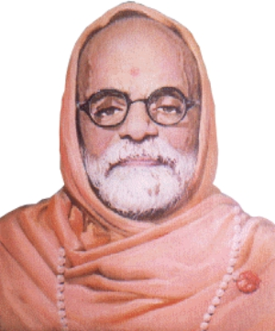
विभागीय वैदिक गणित
प्रश्न मंच 2023
किशोर वर्ग

Slide 2

pdz %& 1-Hkkjr ds izeq[k xf.krkpk;Z

Slide 3

00:30
00:29
00:28
00:27
00:26
00:25
00:24
00:23
00:22
00:21
00:20
00:19
00:18
00:17
00:16
00:15
00:14
00:13
00:12
00:11
00:10
00:09
00:08
00:07
00:06
00:05
00:04
00:03
00:02
00:01
00:00
1
आर्यभट्ट का जन्म किस ईसवी में हुआ था?
उत्तर & 476 ई-

Slide 4
00:30
00:29
00:28
00:27
00:26
00:25
00:24
00:23
00:22
00:21
00:20
00:19
00:18
00:17
00:16
00:15
00:14
00:13
00:12
00:11
00:10
00:09
00:08
00:07
00:06
00:05
00:04
00:03
00:02
00:01
00:00
2
वराहमिहिर का जन्म किस ईसवी में हुआ था?
उत्तर & 499 ई-

Slide 5
00:30
00:29
00:28
00:27
00:26
00:25
00:24
00:23
00:22
00:21
00:20
00:19
00:18
00:17
00:16
00:15
00:14
00:13
00:12
00:11
00:10
00:09
00:08
00:07
00:06
00:05
00:04
00:03
00:02
00:01
00:00
3
vk;ZHkVh; uked xzaFk ds fdrus izeq[k Hkkx gS \
mRrj & pkj Hkkx

Slide 6
00:30
00:29
00:28
00:27
00:26
00:25
00:24
00:23
00:22
00:21
00:20
00:19
00:18
00:17
00:16
00:15
00:14
00:13
00:12
00:11
00:10
00:09
00:08
00:07
00:06
00:05
00:04
00:03
00:02
00:01
00:00
4
वृहत संहिता ग्रंथ के कितने खंड है \
उत्तर - 5 खंड

Slide 7
00:30
00:29
00:28
00:27
00:26
00:25
00:24
00:23
00:22
00:21
00:20
00:19
00:18
00:17
00:16
00:15
00:14
00:13
00:12
00:11
00:10
00:09
00:08
00:07
00:06
00:05
00:04
00:03
00:02
00:01
00:00
5
गीतिका पद में कितने श्लोक हैं ?
उत्तर – 13 श्लोक

Slide 8
00:30
00:29
00:28
00:27
00:26
00:25
00:24
00:23
00:22
00:21
00:20
00:19
00:18
00:17
00:16
00:15
00:14
00:13
00:12
00:11
00:10
00:09
00:08
00:07
00:06
00:05
00:04
00:03
00:02
00:01
00:00
6
वराहमिहिर के पिता का नाम क्या था ?
उत्तर - आदित्य दास

Slide 9
00:30
00:29
00:28
00:27
00:26
00:25
00:24
00:23
00:22
00:21
00:20
00:19
00:18
00:17
00:16
00:15
00:14
00:13
00:12
00:11
00:10
00:09
00:08
00:07
00:06
00:05
00:04
00:03
00:02
00:01
00:00
7
आर्यभट्ट ने आर्यभVh; नामक ग्रंथ की रचना किस सन में किया था ?
उत्तर - सन 499 ई.

Slide 10
00:30
00:29
00:28
00:27
00:26
00:25
00:24
00:23
00:22
00:21
00:20
00:19
00:18
00:17
00:16
00:15
00:14
00:13
00:12
00:11
00:10
00:09
00:08
00:07
00:06
00:05
00:04
00:03
00:02
00:01
00:00
8
पंच सिद्धांतिका नामक ग्रंथ की रचना किस गणितज्ञ ने किया था?
उत्तर - वराहमिहिर

Slide 11
00:30
00:29
00:28
00:27
00:26
00:25
00:24
00:23
00:22
00:21
00:20
00:19
00:18
00:17
00:16
00:15
00:14
00:13
00:12
00:11
00:10
00:09
00:08
00:07
00:06
00:05
00:04
00:03
00:02
00:01
00:00
9
आर्यभट्ट के अनुसार π (पाई) का मन लगभग कितना होता है?
उत्तर - 3.1416

Slide 12
00:30
00:29
00:28
00:27
00:26
00:25
00:24
00:23
00:22
00:21
00:20
00:19
00:18
00:17
00:16
00:15
00:14
00:13
00:12
00:11
00:10
00:09
00:08
00:07
00:06
00:05
00:04
00:03
00:02
00:01
00:00
10
वराहमिहिर का जन्म किस स्थान में हुआ था?
उत्तर & dk;Fkk ¼dkf;RFkdk ½++

Slide 13
00:30
00:29
00:28
00:27
00:26
00:25
00:24
00:23
00:22
00:21
00:20
00:19
00:18
00:17
00:16
00:15
00:14
00:13
00:12
00:11
00:10
00:09
00:08
00:07
00:06
00:05
00:04
00:03
00:02
00:01
00:00
11
आर्यभट्ट को अरबवाlh किस नाम से पुकारते थे?
उत्तर - अरज भर

Slide 14
00:30
00:29
00:28
00:27
00:26
00:25
00:24
00:23
00:22
00:21
00:20
00:19
00:18
00:17
00:16
00:15
00:14
00:13
00:12
00:11
00:10
00:09
00:08
00:07
00:06
00:05
00:04
00:03
00:02
00:01
00:00
12
वराहमिहिर के 5 वे ग्रंथ का नाम क्या है?
उत्तर - विवाह पटल

Slide 15
00:30
00:29
00:28
00:27
00:26
00:25
00:24
00:23
00:22
00:21
00:20
00:19
00:18
00:17
00:16
00:15
00:14
00:13
00:12
00:11
00:10
00:09
00:08
00:07
00:06
00:05
00:04
00:03
00:02
00:01
00:00
13
आर्यभटh; नामक ग्रंथ के गोल पkद में कितने श्लोक हैं ?
उत्तर - 50 श्लोक

Slide 16
00:30
00:29
00:28
00:27
00:26
00:25
00:24
00:23
00:22
00:21
00:20
00:19
00:18
00:17
00:16
00:15
00:14
00:13
00:12
00:11
00:10
00:09
00:08
00:07
00:06
00:05
00:04
00:03
00:02
00:01
00:00
14
आर्यभट्ट का जन्म किस प्रांत में हुआ था ?
उत्तर - बिहार

